Slide 1
Chapter 13: Linear Optimization
Business Analytics: Methods, Models,
and Decisions, 1st edition
James R. Evans

Slide 2


Slide 3
Chapter 13 Topics
Building Linear Optimization Models
Implementing Linear Optimization Models on Spreadsheets
Solving Linear Optimization Models
Graphical Interpretation of Linear Optimization
How Solver Works
Solver Outcomes and Solution Messages
Using Optimization Models for Prediction and Insight

Slide 4
Building Linear Optimization Models
Optimization is the process of selecting values of decision variables that minimize or maximize some quantity of interest.
Steps for building an optimization model
1. Identify the decision variables.
2. Identify the objective function.
3. Identify all appropriate constraints.
4. Write the objective function and constraints as
mathematical expressions.

Slide 5
Building Linear Optimization Models
Decision variables are the unknown values that the model seeks to determine.
The objective function is the quantity we seek to maximize or minimize.
Constraints are limitations, requirements, or other restrictions that are imposed on any solution.

Slide 6
Building Linear Optimization Models
Example 13.1 Sklenka Ski Company: Identifying Model Components
Sells 2 snow ski models - Jordanelle & Deercrest
Manufacturing requires - fabrication and finishing
Decision variables - quantities of each ski model to manufacture
Objective - maximize profit
Constraints
- labor hours available for fabrication and finishing
- relative sales for the two ski models

Slide 7
Building Linear Optimization Models
Example 13.2 Sklenka Ski Company: Modeling the Objective Function
Define the decision variables
- Jordanelle is the number of pairs of Jordanelle skis to manufacture per day
- Deercrest is the number of pairs of Deercrest skis to manufacture per day
Profit per pair of skis sold:
$50 for Jordanelle skis, $65 for Deercrest skis
Objective Function:
Maximize profit = 50 Jordanelle + 65 Deercrest

Slide 8
Building Linear Optimization Models
Example 13.3 Sklenka Ski Company: Modeling the Constraints
Available fabrication labor hours:
12 workers at 7 hours/ day = 84 hours/day
Required fabrication labor hours per ski pair:
3.5 hours for Jordanelle, 4 hours for Deercrest
Fabrication constraint:
3.5 Jordanelle + 4 Deercrest ≤ 84

Slide 9
Building Linear Optimization Models
Example 13.3 (continued) Sklenka Ski Company: Modeling the Constraints
Available finishing labor hours:
3 workers at 7 hours/ day = 21 hours/day
Required finishing labor hours per ski pair:
1 hour for Jordanelle; 1.5 hours for Deercrest
Finishing constraint:
1 Jordanelle + 1.5 Deercrest ≤ 21

Slide 10
Building Linear Optimization Models
Example 13.3 (continued) Sklenka Ski Company: Modeling the Constraints
The number of pairs of Deercrest skis must be at least twice the number of Jordanelle skis.
Market mixture constraint:
Deercrest ≥ 2 Jordanelle
−2 Jordanelle + 1 Deercrest ≥ 0
Nonnegativity constraints:
Jordanelle ≥ 0
Deercrest ≥ 0

Slide 11
Building Linear Optimization Models
SSC (Sklenka Ski Company) Optimization Model
Maximize profit = 50 Jordanelle + 65 Deercrest
3.5 Jordanelle + 4 Deercrest ≤ 84
1 Jordanelle + 1.5 Deercrest ≤ 21
−2 Jordanelle + 1 Deercrest ≥ 0
Jordanelle ≥ 0
Deercrest ≥ 0

Slide 12
Building Linear Optimization Models
Example 13.4 Modeling a Mixture Constraint
A fertilizer mixture is made of 2 ingredients and must contain exactly 30% nitrogen.
Ingredient X contains 20% nitrogen
Ingredient Y contains 33% nitrogen
x is the pounds of X in the mixture
y is the pounds of Y in the mixture
Amount of nitrogen in mixture = 0.20x + 0.33y
Fraction nitrogen in mix = (0.20x + 0.33y)/(x + y)

Slide 13
Building Linear Optimization Models
Example 13.4 (continued) Modeling a Mixture Constraint
Fraction nitrogen in mixture = 30%
0.20x + 0.33y
x + y
(0.20x + 0.33y) = 0.30(x + y)
Linear form of constraint
-1x + 0.33y = 0
= 0.30

Slide 14
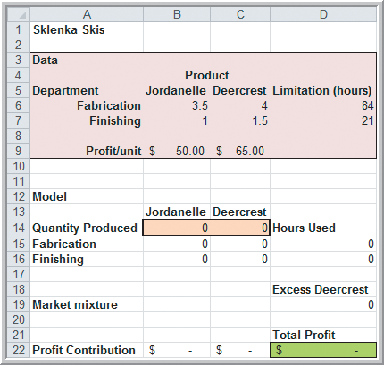
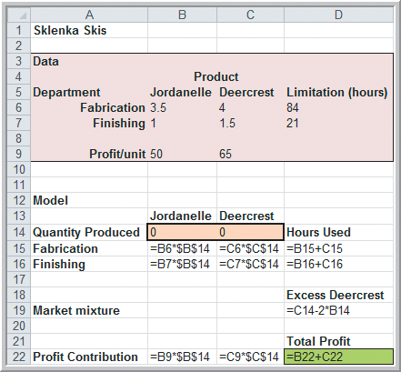
Implementing Linear Optimization Models on Spreadsheets
Example 13.5
A Spreadsheet Model for Sklenka Skis
Decision
variables
(cells B14
and C14)
Objective
value
(cell D22)
Figure 13.1

Slide 15
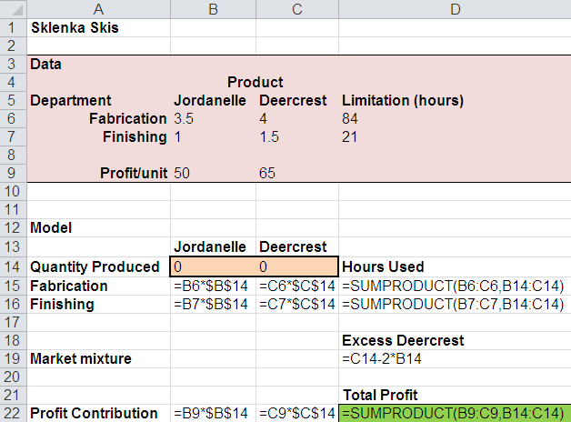
Implementing Linear Optimization Models on Spreadsheets
Example 13.5 (continued)
A Spreadsheet Model for Sklenka Skis
An alternative worksheet using SUMPRODUCT
From Figure 13.1

Slide 16
Solving Linear Optimization Models
A feasible solution to an optimization problem is any solution that satisfies all of the constraints.
The optimal solution is the best of all the feasible solutions.
Software for determining optimal solutions
- Solver is a free add-in packaged with Excel for
solving optimization problems.
- Risk Solver and Premium Solver, which
accompany the textbook, have better
functionality, accuracy, reporting, and interface.

Slide 17
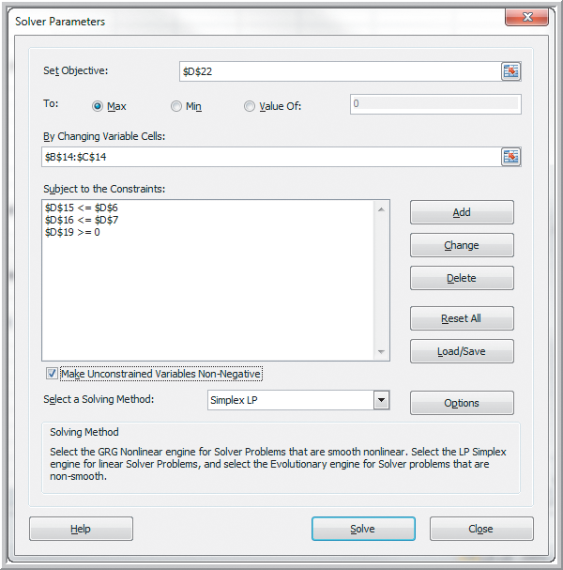
Solving Linear Optimization Models
Example 13.6
Using Standard Solver
for the SSC Problem
From Figure 13.1
Figure 13.2

Slide 18
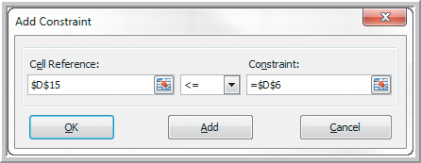
Solving Linear Optimization Models
Example 13.6 (continued)
Using Standard Solver for the SSC Problem
Data
Solver
Set Objective: D22
To: Max
By Changing Variable Cells: B14:C14
Add Constraints: D15:D16 ≤ D6:D7
D19 ≥ 0
Make Unconstrained Variables Non-Negative
Select a Solving Method: Simplex LP
Figure 13.3

Slide 19
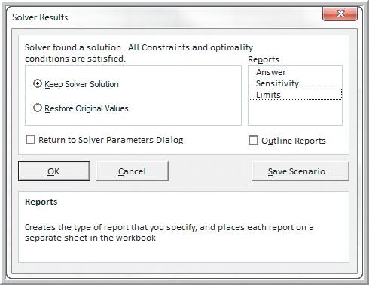
Solving Linear Optimization Models
Example 13.6 (continued)
Using Standard Solver for the SSC Problem
Selecting
Outline Reports
will produce 3
output reports.
Figure 13.4

Slide 20
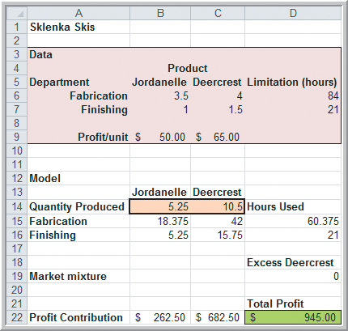
Solving Linear Optimization Models
Example 13.6 (continued)
Using Standard Solver for the SSC Problem
Optimal Solution to Sklenka Skis
Profit = $945/day
Jordanelle = 5.25
Deercrest = 10.5
Figure 13.5

Slide 21
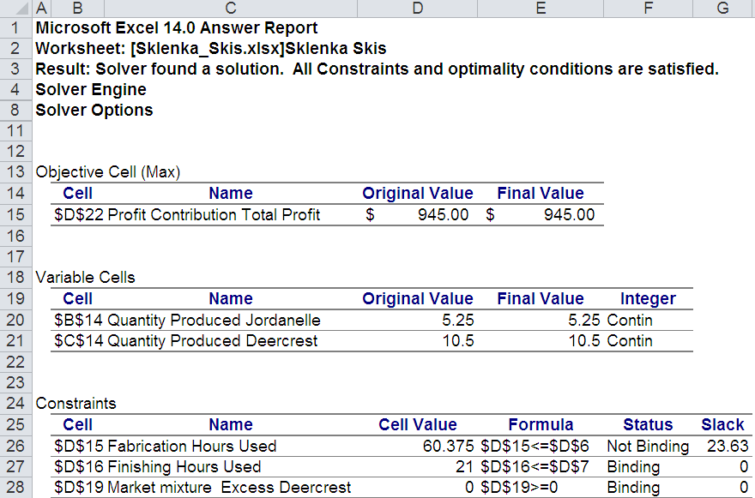
Solving Linear Optimization Models
Example 13.6 (continued)
Using Standard Solver for the SSC Problem
Answer Report for Sklenka Skis

Slide 22
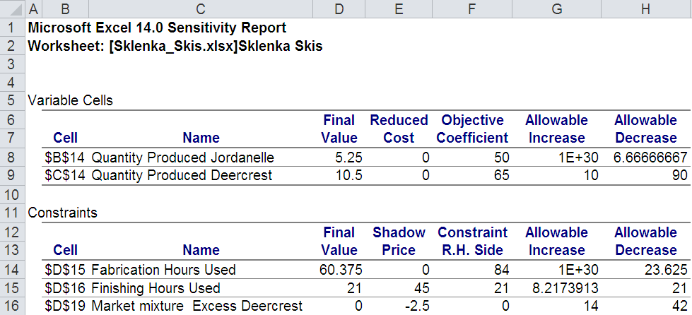
Solving Linear Optimization Models
Example 13.6 (continued)
Using Standard Solver for the SSC Problem
Sensitivity Report for Sklenka Skis

Slide 23
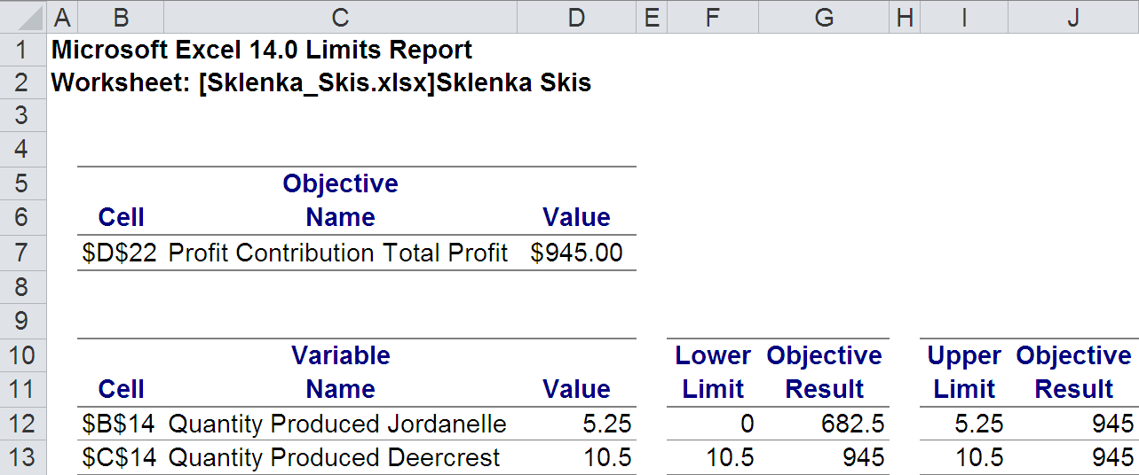
Solving Linear Optimization Models
Example 13.6 (continued)
Using Standard Solver for the SSC Problem
Limits Report for Sklenka Skis

Slide 24
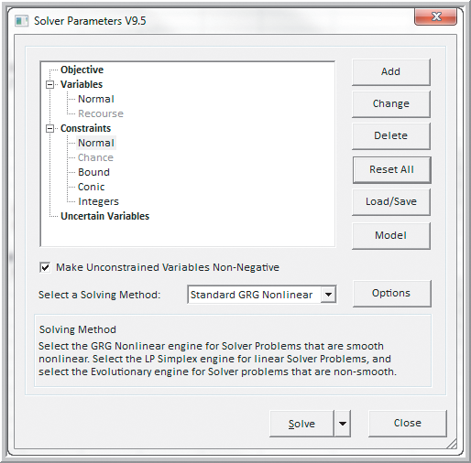
Solving Linear Optimization Models
Example 13.7
Using Premium Solver for the SSC Problem
Add-Ins
Premium Solver
Objective
Add: D22 (Max)
Variables - Normal
Add: D15:D16 ≤ D6:D7
Constraints - Normal
Add: D19 ≥ 0
Make Unconstrained
Variables Non-Negative
Select a Solving Method:
Standard LP/Quadratic
Parameter dialog box before making changes
Figure 13.6

Slide 25
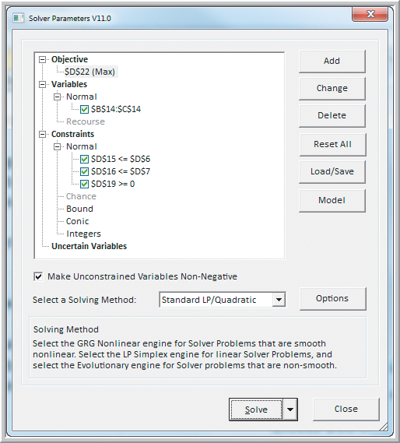
Solving Linear Optimization Models
Example 13.7 (continued)
Using Premium Solver for the SSC Problem
Completed parameter dialog box
Figure 13.7

Slide 26
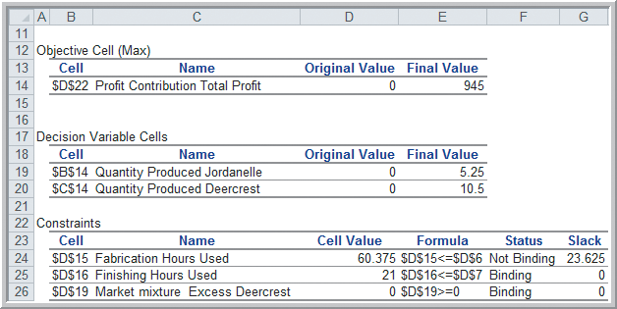
Solving Linear Optimization Models
Example 13.8 Interpreting the SSC Answer Report
Figure 13.8
Not Binding constraints have slack (cell value ≠ RHS).
We have 23.625 excess finishing hours.
Binding constraints have 0 slack (cell value = RHS).
No excess finishing hours
No excess market mix of Deercrest skis

Slide 27
Building Linear Optimization Models
Example 13.8 (continued) Interpreting the SSC Answer Report
Maximize profit = 50 Jordanelle + 65 Deercrest
3.5 Jordanelle + 4 Deercrest ≤ 84
1 Jordanelle + 1.5 Deercrest ≤ 21
−2 Jordanelle + 1 Deercrest ≤ 0
Jordanelle ≥ 0
Deercrest ≥ 0
Optimal Solution to Sklenka Skis
Profit = $945/day
Jordanelle = 5.25
Deercrest = 10.5
Profit = 50(5.25) + 65(10.5) = 945
3.5(5.25) + 4(10.5) = 60.375 ≤ 84 → 23.625 excess fabrication hours
1(5.25) + 1.5(10.5) = 21 ≤ 21 → No excess finishing hours
−2(5.25) + 1(10.5) = 0 ≤ 0 → No excess Deercrest skis
5.25 ≥ 0
10.5 ≥ 0

Slide 28
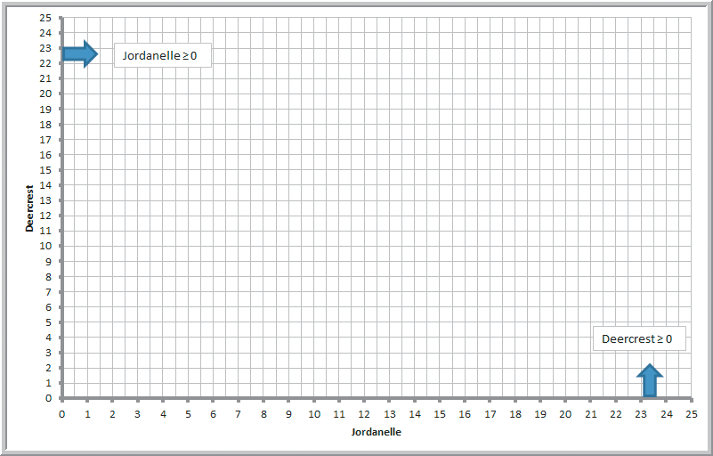
Graphical Interpretation of Linear Optimization
Example 13.9
Graphing the Constraints in the SSC Problem
Nonnegativity constraints
Figure 13.9

Slide 29
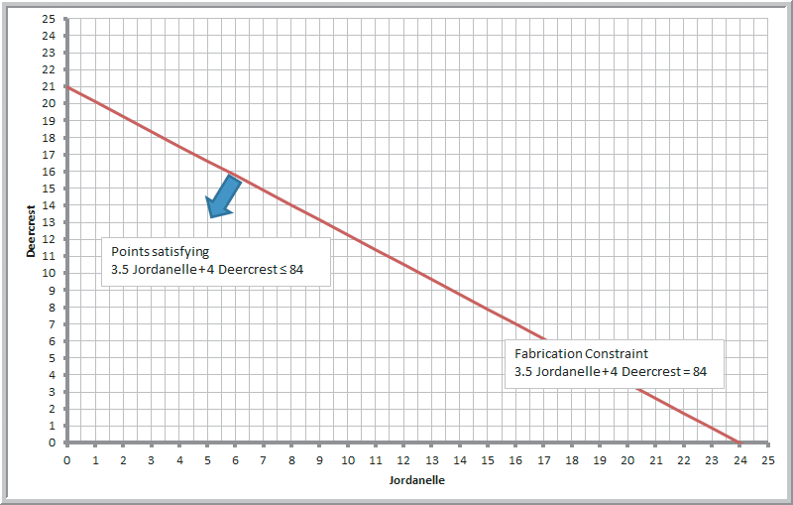
Graphical Interpretation of Linear Optimization
Example 13.9 (continued)
Graphing the Constraints in the SSC Problem
Fabrication
constraint endpoints
Jordanelle = 0
Deercrest ≤ 21
→ graph (0, 21)
Deercrest = 0
Jordanelle ≤ 24
→ graph (24, 0)
Figure 13.10

Slide 30
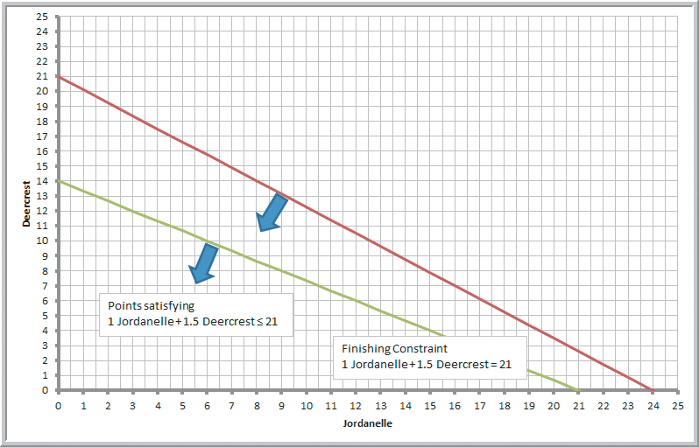
Graphical Interpretation of Linear Optimization
Example 13.9 (continued)
Graphing the Constraints in the SSC Problem
Finishing
constraint endpoints
Jordanelle = 0
Deercrest ≤ 1,
→ graph (0, 14)
Deercrest = 0
Jordanelle ≤ 21
→ graph (21, 0)
Figure 13.11

Slide 31
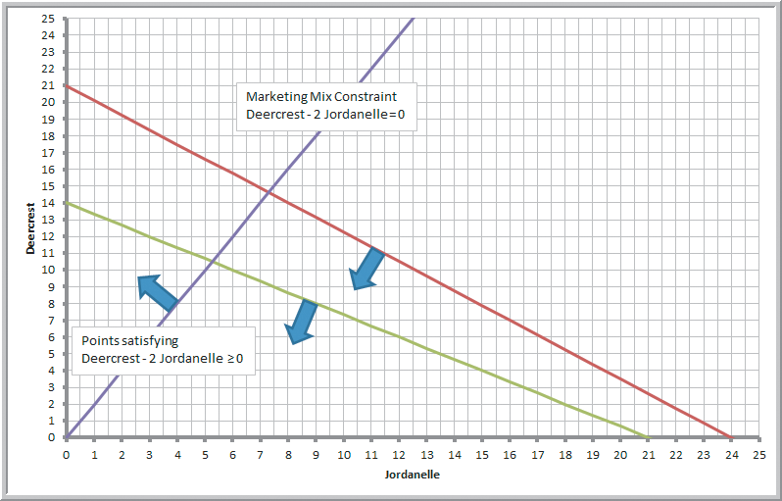
Graphical Interpretation of Linear Optimization
Example 13.9 (continued)
Graphing the Constraints in the SSC Problem
Marketing Mix
constraint
Jordanelle = 0
Deercrest = 0
→ graph (0, 0)
Deercrest = 25
Jordanelle = 12.5
→ graph (12.5, 25)
Figure 13.12

Slide 32
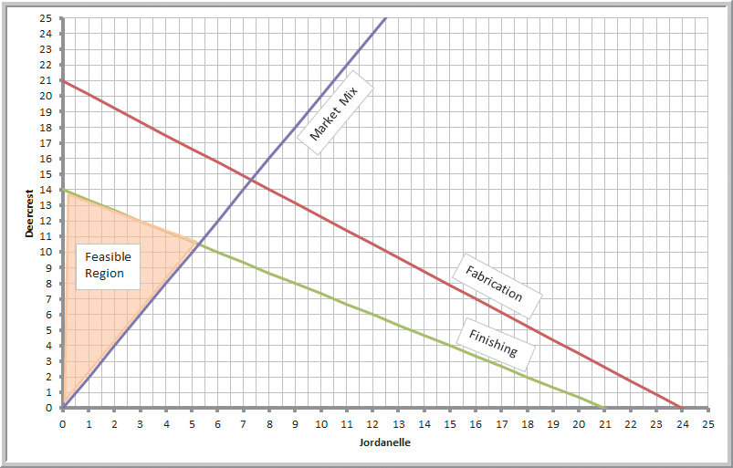
Graphical Interpretation of Linear Optimization
Example 13.10 Identifying the Feasible Region and Optimal Solution
Feasible region
the set of points that satisfy all constraints simultaneously
Figure 13.13

Slide 33
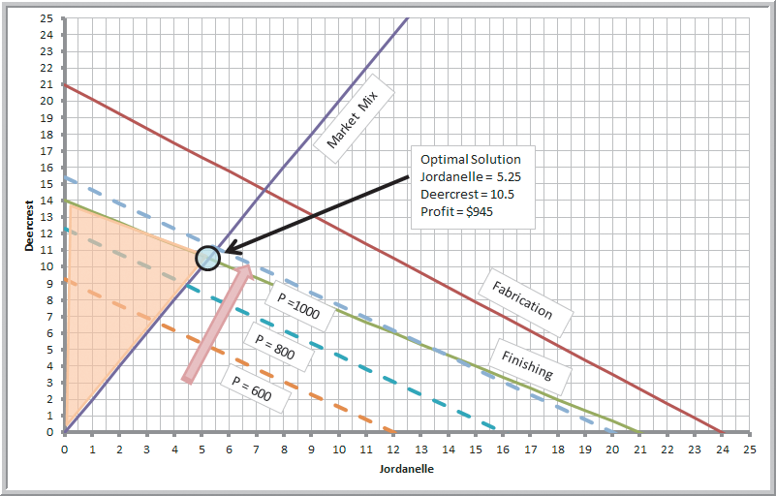
Graphical Interpretation of Linear Optimization
Example 13.10 (continued) Identifying the Feasible Region and Optimal Solution
Optimal solution
maximizes
50 Jordanelle +
65 Deercrest
Set Profit = 600
Line endpoints:
(0, 9) and (12, 0)
Move profit line up until it hits a corner point on feasible region.
Figure 13.14

Slide 34
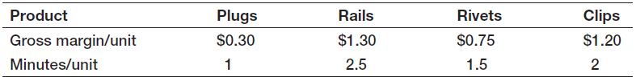
How Solver Works
Example 13.11 Crebo Manufacturing
Crebo Manufacturing produces 4 types of structural support fittings.
Machining centers have a capacity of 280,000 minutes per year.
How many units of each product type should be produced to maximize gross profit margin?

Slide 35
How Solver Works
Example 13.11 (continued) Crebo Manufacturing
Define X₁, X₂, X₃, and X₄ as the number of plugs, rails, rivets, and clips to produce.
Maximize gross profit margin =
0.3 X₁ + 1.3 X₂ + 0.75X₃ + 1.2X₄
Subject to constraints
1X₁ + 2.5 X₂ + 1.5X₃ + 2X₄ ≤ 280,000
X₁, X₂, X₃, X₄ ≥ 0

Slide 36
How Solver Works
Example 13.12
Solving the Crebo Manufacturing Model
Gross margin per minute machining required
= gross margin/unit ÷ minutes/unit
= $1.20 ÷ 2 = $0.60 for clips
Maximum possible production for each item
= 280,000 minutes ÷ minutes/unit
= 280,000 ÷ 2 = 140,000 for clips
Profit for maximum production of each item
= gross margin/unit * max possible production
= $1.20 * 140,000 = $168,000 for clips

Slide 37
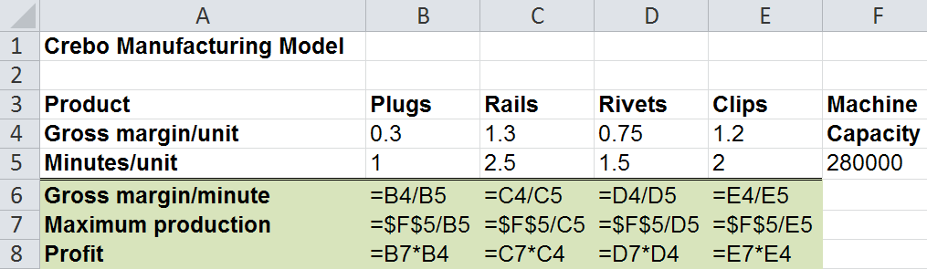
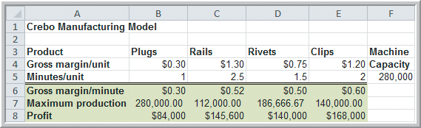
How Solver Works
Example 13.12 (continued)
Solving the Crebo Manufacturing Model
Clips have the highest marginal profit per unit of resource consumed.
Figure 13.15

Slide 38
How Solver Works
How Solver Creates Names in Reports
Solver assigns names to:
Target cells
Changing cells
Constraint function cells
Names are formed by concatenating the first cell containing text to the:
Left of the cell and
Above the cell

Slide 39
How Solver Works
How Solver Creates Names in Reports (continued)
Target cell D22 name:
Profit Contribution Total Profit
Changing cell B14 name:
Quantity Produced Jordanelle
Constraint function cell D15 name:
Fabrication Hours Used
Figure 13.1

Slide 40
How Solver Works
Difficulties with Solver
Poorly scaled models:
Occur when model parameters differ by several orders of magnitude (e.g.; differ by a factor of 1000 or 10,000 or more)
Consequences of poorly scaled models:
May cause rounding errors
May result in an error message indicating the assumptions of a linear model are not met
How to deal with poorly scaled models:
Try choosing the option: Use Automatic Scaling

Slide 41
Solver Outcomes and Solution Messages
Four Possible Outcomes when Solving a Linear Optimization Model
Unique optimal solution
Alternate optimal solutions
Unbounded solution
Infeasible solution

Slide 42
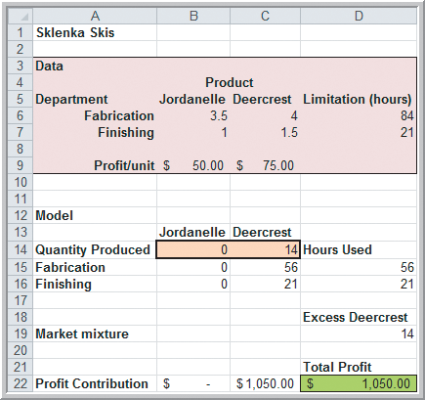
Solver Outcomes and Solution Messages
Example 13.13
A Model with Alternative Optimal Solutions
Solution to the Sklenka Ski problem using a revised objective function coefficient:
Profit for Deercrest skis = $75/pair
(instead of $65/pair)
Maximized Profit = $1050
(instead of $945)
Figure 13.16

Slide 43
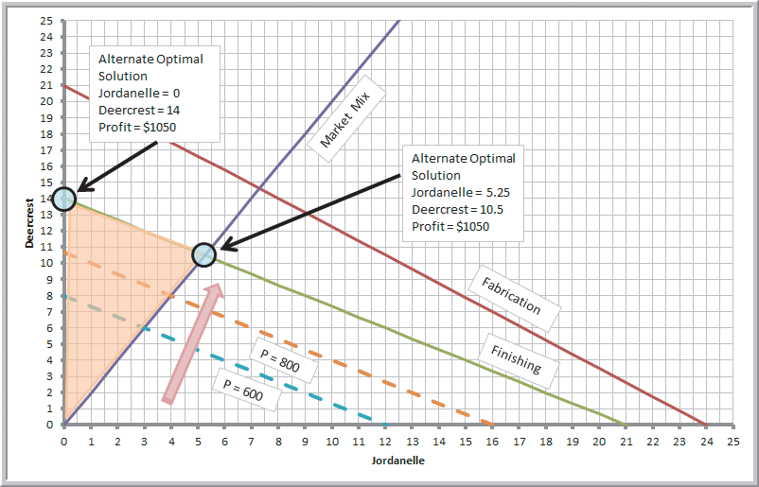
Solver Outcomes and Solution Messages
Example 13.13 (continued)
A Model with Alternative Optimal Solutions
The objective function is now parallel to the binding finishing constraint.
All points on the line between
(0, 14) and
(5.25, 10.5)
are optimal
Figure 13.17

Slide 44
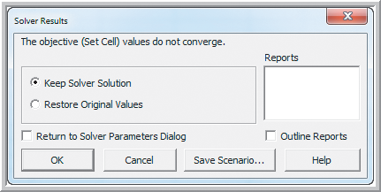
Solver Outcomes and Solution Messages
Example 13.14
A Model with an Unbounded Solution
Suppose we remove the finishing and fabrication constraints from the Sklenka Ski problem.
Figure 13.18

Slide 45
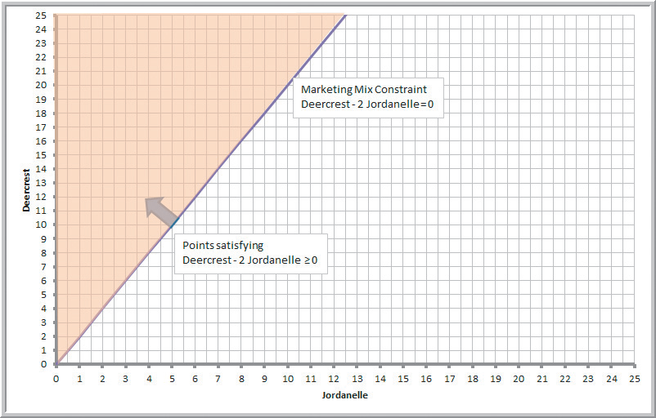
Solver Outcomes and Solution Messages
Example 13.14 (continued)
A Model with an Unbounded Solution
There are no constraints to prevent the profit function from increasing to infinity.
Figure 13.19

Slide 46
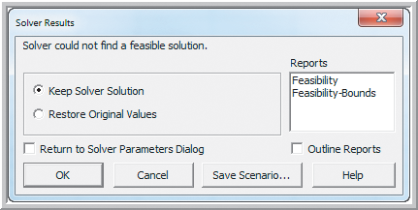
Solver Outcomes and Solution Messages
Example 13.15 A Model with an Infeasible Solution
Suppose, by mistake, the modeler in the Sklenka Ski problem used a ≥ sign in the fabrication constraint (instead of ≤).
Figure 13.20

Slide 47
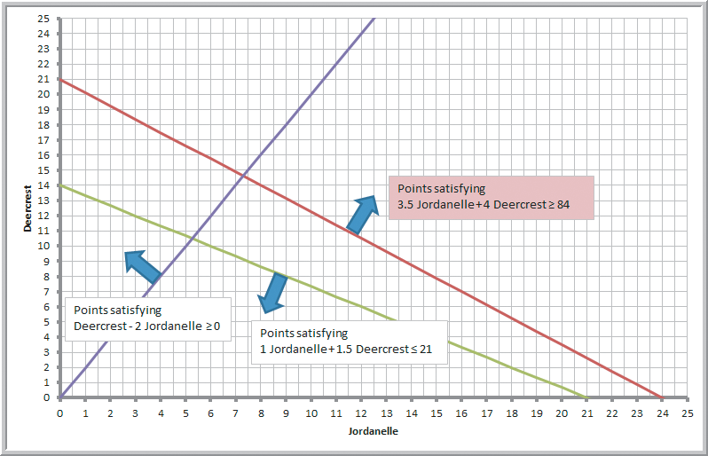
Solver Outcomes and Solution Messages
Example 13.15 (continued) A Model with an Infeasible Solution
There are no points that satisfy all of the constraints.
Figure 13.21

Slide 48
Using Optimization Models for Prediction and Insight
Example 13.16 Using Solver for What-If-Analysis
Four questions are posed by the managers of Sklenka Ski company:
If the Jordanelle ski’s profit increased $10/pair, how would the optimal solution change?
If the Jordanelle ski’s profit decreased $10/pair, how would the optimal solution change?
If 10 additional finishing hours were available, how would manufacturing plans be affected?
If 2 fewer finishing hours were available, how would manufacturing plans be affected?

Slide 49
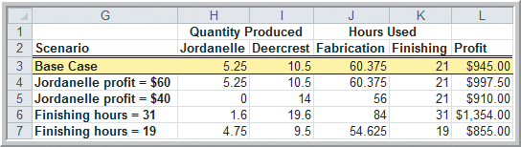
Using Optimization Models for Prediction and Insight
Example 13.16 (continued) Using Solver for What-If-Analysis
Figure 13.22.
Base Case is the original model shown to the left.
The solutions (shown above) to the other 4 scenarios were obtained by re-solving the model.
Figure 13.5

Slide 50
Using Optimization Models for Prediction and Insight
Example 13.16 (continued) Using Solver for What-If-Analysis
Figure 13.22.
If Jordanelle profit increases $10 → profit increases $52.50
If Jordanelle profit decreases $10 → profit decreases $35
If finishing hours increase by 10 → profit increases $409
If finishing hours decrease by 2 → profit decreases $90

Slide 51
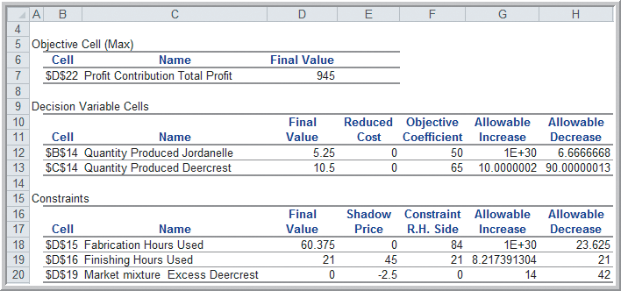
Using Optimization Models for Prediction and Insight
Solver Sensitivity Report: Shows what happens to the optimal solution if a single model parameter changes (all others stay at their original values)
Figure 13.23

Slide 52
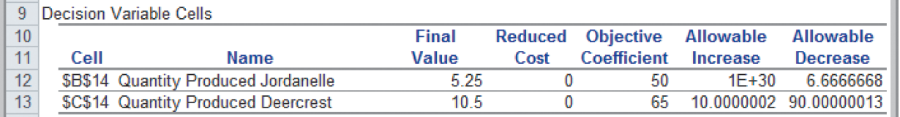
Using Optimization Models for Prediction and Insight
Example 13.17 Interpreting Sensitivity Information for Decision Variables
Decision Variable Part of the Sklenka Ski Sensitivity Report
Reduced Cost: How much the objective function coefficient needs to be reduced for a variable that equals zero to become positive
Allowable Increase/Decrease: How much an objective function coefficient can change before the optimal values of the decision variables change
From Figure 13.23

Slide 53
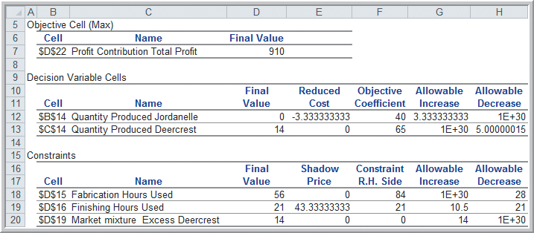
Using Optimization Models for Prediction and Insight
Example 13.18
Understanding Nonzero Reduced Costs
Sensitivity report for the Sklenka Ski model after reducing profit on Jordanelle skis from $50 to $40
Produce no Jordanelle skis unless profit/pair increases $3.34.
Figure 13.24

Slide 54
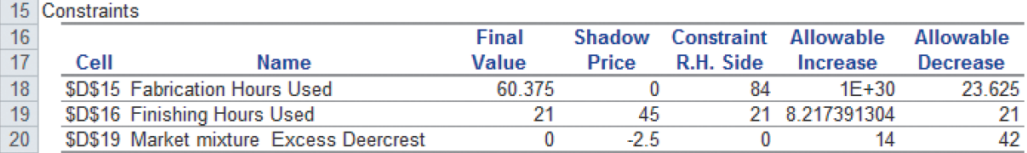
Using Optimization Models for Prediction and Insight
Example 13.19
Interpreting Sensitivity Information for Constraints
Decision variable part of the Sklenka Ski sensitivity report
Shadow Price - how much the objective function will change as the right hand side of a constraint is increased by 1
Allowable Increase/Decrease - how much a constraint’s right hand side can change before the optimal values of the decision variables change
From Figure 13.23

Slide 55
Using Optimization Models for Prediction and Insight
Example 13.19 (continued)
Interpreting Sensitivity Information for Constraints
Profit increases $45 per additional finishing hour (up to 8.2 extra hours).
Figure 13.23

Slide 56
Using Optimization Models for Prediction and Insight
Example 13.19 (continued)
Interpreting Sensitivity Information for Constraints
Profit decreases $2.5 per
1 unit increase in the RHS of the market mixture constraint.
Figure 13.23

Slide 57
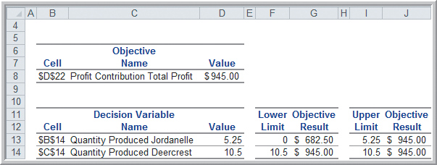
Using Optimization Models for Prediction and Insight
The Limits Report
Shows the upper and lower limits that each decision variable can assume while satisfying all constraints and holding the other variables constant.
Limits Report for Sklenka Skis
Figure 13.25

Slide 58
Using Optimization Models for Prediction and Insight
Example 13.20 (continued)
Using Sensitivity Information to Evaluate Scenarios
1. If the Jordanelle ski’s profit increased $10/pair,
how would the optimal solution change?
From Figure 13.23
$10 is within the allowable increase.
Only profit would change.
Profit would increase by $10*5.25 = $52.50

Slide 59
Using Optimization Models for Prediction and Insight
Example 13.20 (continued)
Using Sensitivity Information to Evaluate Scenarios
2. If the Jordanelle ski’s profit decreased $10/pair,
how would the optimal solution change?
From Figure 13.23
$10 is not within the allowable decrease.
We need to re-solve the problem to answer the question.

Slide 60
Using Optimization Models for Prediction and Insight
Example 13.20 (continued)
Using Sensitivity Information to Evaluate Scenarios
3. If 10 additional finishing hours were available,
how would manufacturing plans be affected?
From Figure 13.23
10 is not within the allowable increase.
We need to re-solve the problem to answer the question.

Slide 61
Using Optimization Models for Prediction and Insight
Example 13.20 (continued)
Using Sensitivity Information to Evaluate Scenarios
4. If 2 fewer finishing hours were available, how
would manufacturing plans be affected?
From Figure 13.23
2 is within the allowable decrease.
Only profit would change.
Profit would decrease by $45*2 = $90.

Slide 62
Using Optimization Models for Prediction and Insight
Parameter Analysis for the SSC Problem
Solver can be used to perform sensitivity analysis by either:
Examining the sensitivity reports or
Changing data in the model and re-solving it
Risk Solver Platform offers an alternative approach to sensitivity analysis:
Parameter analysis allows multiple optimizations within predefined ranges of the parameters.

Slide 63
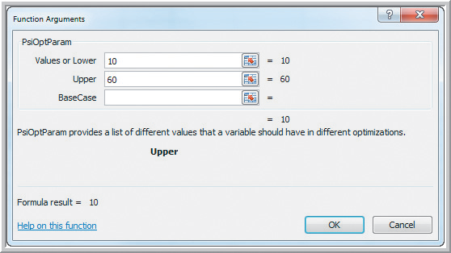
Using Optimization Models for Prediction and Insight
Example 13.21
Parameter Analysis for the SSC Problem
Use Risk Solver Platform to investigate changing finishing hours over a range from 10 to 60.
Choose an empty cell on the Sklenka Ski worksheet (e.g.; F3)
Risk Solver
Parameters
Optimization
Values or Lower: 10
Upper: 60
Figure 13.26

Slide 64
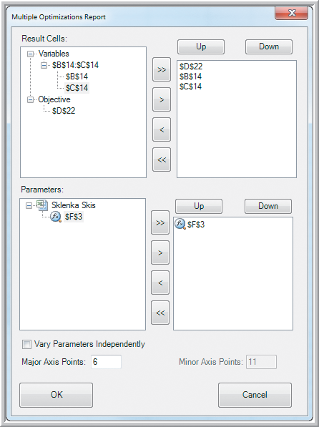
Using Optimization Models for Prediction and Insight
Example 13.21 (continued)
Parameter Analysis for SSC
Replace cell D7 with =F3
or replace D7 with:
=PsiOptParam(10,60)
Reports
Optimization
Parameter Analysis
Variables: D22
B14
C14
Parameters: F3 (or D7)
Major Axis points: 6
Figure 13.27

Slide 65
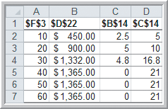
Using Optimization Models for Prediction and Insight
Example 13.21 (continued)
Parameter Analysis for the SSC Problem
Parameter analysis (below) shows changes in both profit and ski quantities as finishing hours change from 10 to 60.
Figure 13.28
Figure 13.5

Slide 66

Using Optimization Models for Prediction and Insight
Analytics in Practice: Using Optimization
Models for Sales Planning at NBC
NBC uses linear optimization models
for its television advertising sales plans.
The objective is to maximize revenue.
The constraints are limited inventories of available commercials for specified time slots.
Decision variables are the number of commercials of each spot length to be included in the shows and weeks available.

Slide 67
Chapter 13 - Key Terms
Alternative optimal solution
Binding constraint
Constraint function
Constraints
Corner point
Decision variables
Feasible region
Feasible solution
Infeasible problem
Linear optimization model (LP model)
Objective function
Optimization
Parameter analysis
Reduced cost
Redundant constraint
Shadow price
Unbounded problem
Unique optimal solution

Slide 68
Case Study Performance Lawn Equipment (13)
Recall that PLE produces lawnmowers and a medium size diesel power lawn tractor.
One of PLE’s manufacturing facilities produces metal engine housings.
The company would like to maximize the total number of housings they can produce in the planning period.
Formulate and solve a linear optimization model and recommend a production plan.
Write a formal report summarizing your results.

Slide 69
